Slide 1
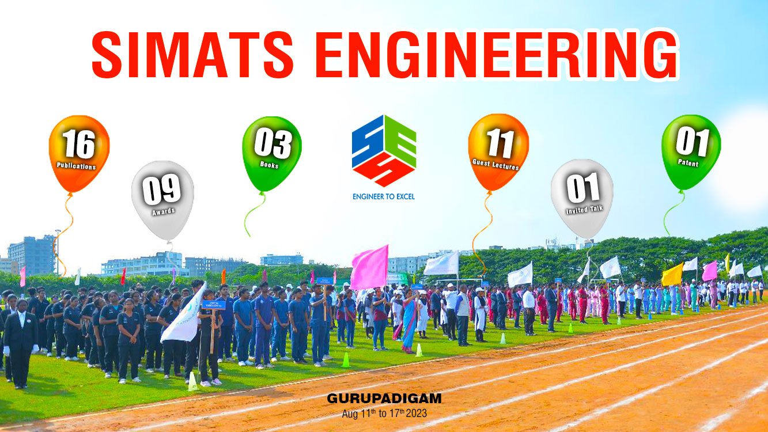

Slide 2
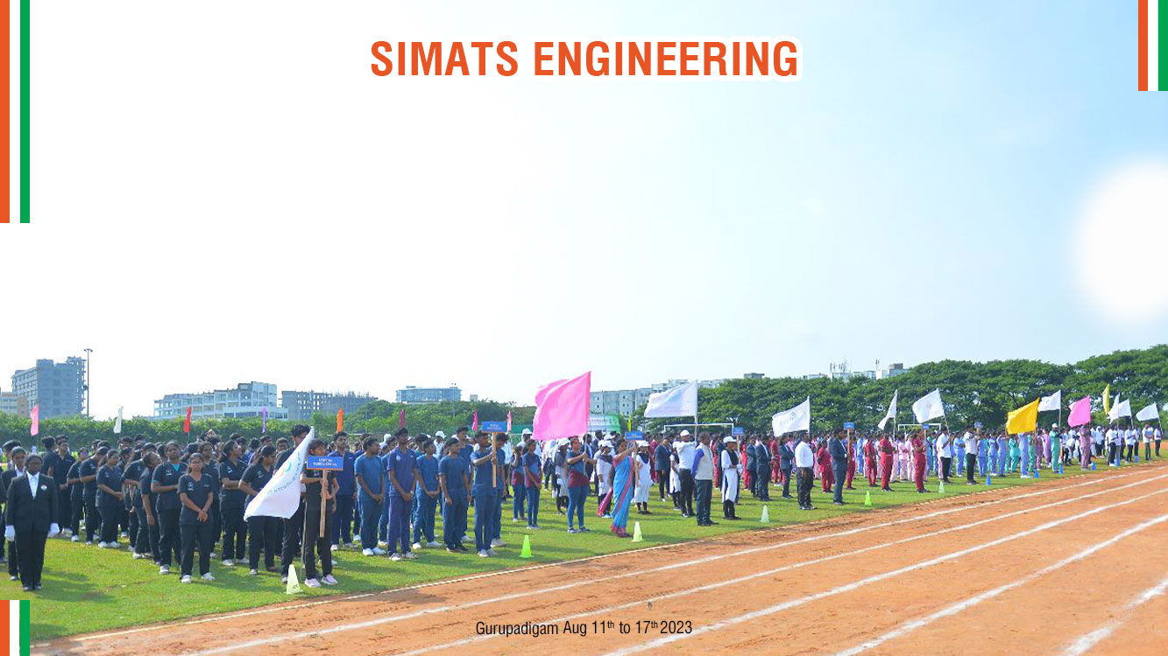
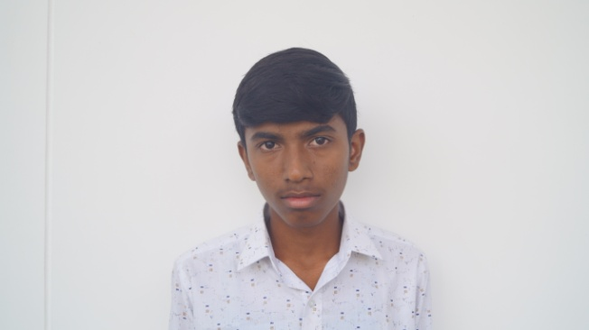
Name: YOGANATH K S
RegNo: 192212134
Batch:2022-26
Year: Second Year
Dept: ECE
No. of Course Completed:5
No. of Credits Completed: 20
No. of Arrears: 6
Ongoing Courses
Slot A : Semiconductor devices for Industrial Applications
Slot B: Computer Networks for 5G Networks
Slot C: Basic Electrical and Electronics Engineering for Domestic Application
Slot D: Probability and Random Processes for Decision Making
Slot C | Attendance Percentage
Basic Electrical and Electronics Engineering for Domestic Application | 100

Slide 3
Dear Parent,
YOGANATH K S, is regularly attending classes . He has registered four courses this semester. The attendance percentage for the ongoing courses is 100% till now. The attendance percentage for the ongoing courses is 100% till now. He has six arrears . Please advice your ward to concentrate on arrear subjects and make him to clear by this semester. Also ask him to attend events like Hackathon, workshops, conferences to built his career.
Thank you
Dr.Almas Begum,
Professor/Applied Machine Learning

Slide 4
MENTEE RESPONSE
PARENT’S RESPONSE
I will improve my studies
He will improve

